Slide 1

SMAI PROJECT
Team - Invictus

Slide 2
PAPER IMPLEMENTATION
“Common Representation Learning
Using
Step-based Correlation Multi-Modal CNN”
By - Gaurav Bhatt
Piyush Jha
Balasubramanian Raman

Slide 3
OBJECTIVE
To make a novel step-based correlation multi-modal CNN (CorrMCNN).
This model can reconstruct one view of the data given the other.
Also increase the interaction between the representations at each hidden layer or every intermediate step.

Slide 4
TECHNIQUES USED FOR “CRL”
The approaches used for implementation of “CRL” of multi-view data can be categorized into 2 categories:
1) Canonical Correlation Analysis (CCA)
2) Autoencoder based Approach

Slide 5
1) Canonical Correlation Analysis
CCA approach is based on matrix factorization method
Maximizes the correlation between two views of data
Project different modalities onto a common subspace.
Limitations:
Suffer from scalability issues
Poor performance for Reconstruction of views

Slide 6
2) Autoencoder Based Approach
Autoencoder are deep neural networks that try to optimize two objective functions:
1) To find a compressed hidden representation of data in a low-dimensional vector space.
2) The other objective is to reconstruct the original data from the compressed low-dimensional subspace.
In this paper, we have used a special type of Autoencoder known as Multimodal Autoencoders

Slide 7
Multi-Modal Autoencoders
MAE are two channeled AE that specifically performs two types of reconstructions.
1) Self-reconstruction of view from itself.
2) Cross-reconstruction where one view is reconstructed given the other.
Why these 2 reconstructions?
These reconstruction objectives provide MAE the ability to adapt towards transfer learning tasks.

Slide 8
Example of MAE - CORRNET
CORRNET or Correlation Neural network is an improvised version of MAE.
Improvement - Introduction of Correlation Term in objective function.
Tries to maximize the correlation between the hidden representations of different views.
Limitations:
Uses simple neural layer for encoding and decoding phase
Uses Final hidden representations in the correlation loss function

Slide 9
Contribution of this Paper
Improvement in the objective function of CorrNet so that it can be used for reconstruction of views.
Contributions:
1) Introducing convolution layer in the encoding phase and deconvolution layer in the decoding stage of the Correlation multi-modal CNN (CorrMCNN)
2) Batch Normalization in the intermediate layers
3) Instead of using final hidden representations in the correlation loss, we tried to compute correlation at each intermediate layer.

Slide 10
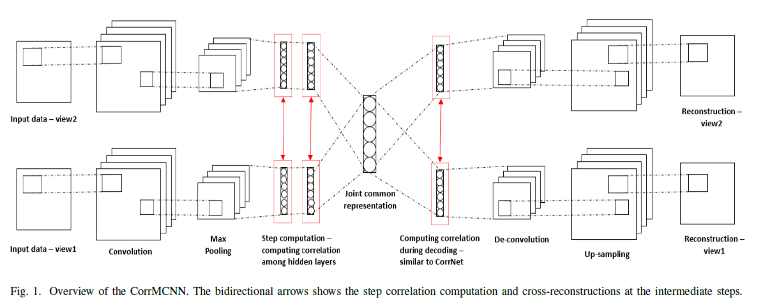
ARCHITECTURE OF CorrMCNN

Slide 11
Technique used to improve results
  Activation Function
    Sigmoid functions are not used because of Vanishing Gradient problem.
    Rectified Linear Unit (ReLU) works like a charm.
  Batch Normalization
    Stabilizing mechanism for training a Neural Network
    Scale the output of hidden layer to zero norm and unit variance.
    Scaling reduce change of distribution between neurons throughout the network.
    Used to increase the training rate providing us with better correlation values.
    Dropout
    Regularization to intermediate dense neural layers.

Slide 12
Our goals while training the model
• Minimize the self-reconstruction error.
• Minimize the cross-reconstruction error at each intermediate step.
• Maximize the correlation between the hidden representation of both views at each encoding step.

Slide 13
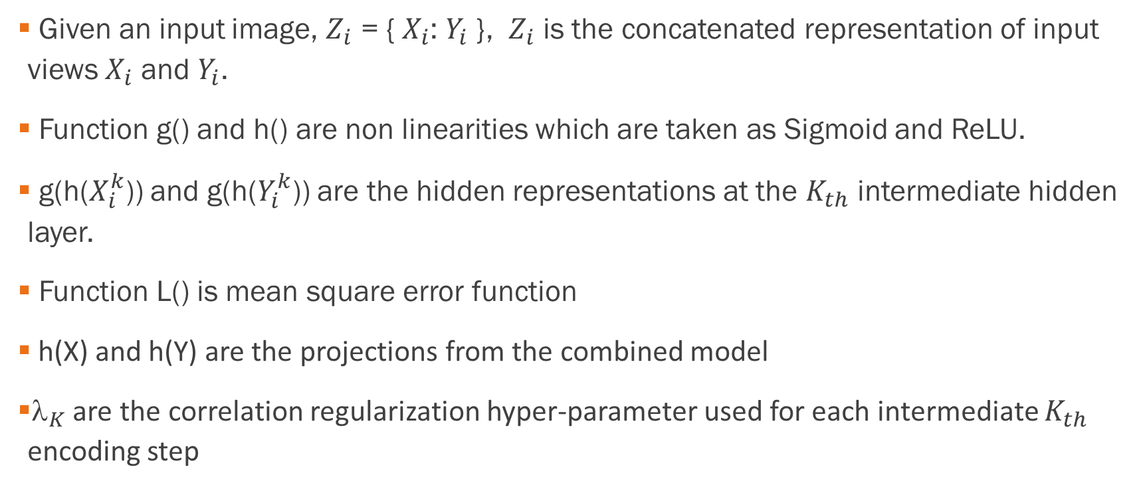
Some Notations…
Given an input image, $Z_{i}$ = { $X_{i}$: $Y_{i}$ }, $Z_{i}$ is the concatenated representation of input views $X_{i}$ and $Y_{i}$.
Function g() and h() are non linearities which are taken as Sigmoid and ReLU.
g(h($X_{i}^{k}$)) and g(h($Y_{i}^{k}$)) are the hidden representations at the $K_{th}$ intermediate hidden layer.
Function L() is mean square error function
h(X) and h(Y) are the projections from the combined model
${\text{}}_{K}$ are the correlation regularization hyper-parameter used for each intermediate $K_{th}$ encoding step

Slide 14
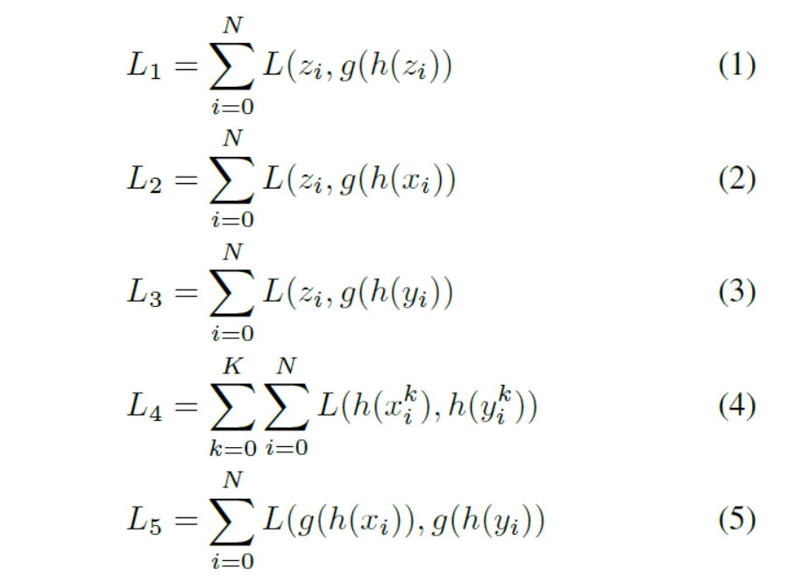
Self and Cross Reconstruction losses
Self Reconstruction Loss
Cross Reconstruction Loss
Loss during Step Computation
Cross Reconstruction Loss

Slide 15
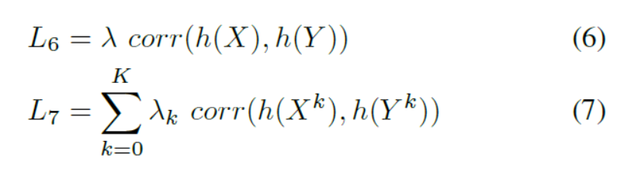
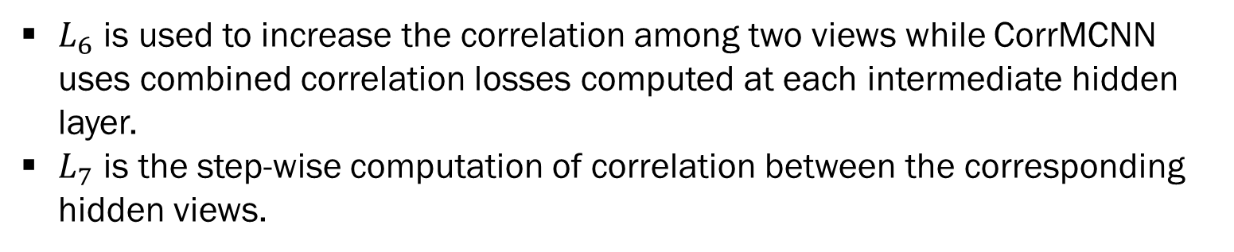
Correlation Loss
To maximize the interaction between 2 views, correlation loss is added.
$L_{6}$ is used to increase the correlation among two views while CorrMCNN uses combined correlation losses computed at each intermediate hidden layer.
$L_{7}$ is the step-wise computation of correlation between the corresponding hidden views.

Slide 16
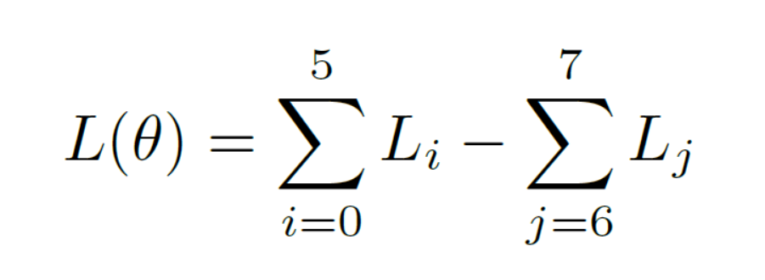
Optimizer Used
CorrMCNN is optimized using the following objective function using Adam as optimizer.
Where θ are the parameters of CorrMCNN.
Here, we minimize the self-reconstruction and cross-reconstruction
Whereas Correlation between the views is maximized.

Slide 17
Vanishing Gradient Problem
A problem with training Deep Neural networks with many layers is that the gradient diminishes dramatically as it is propagated backward through the network.
The error may be so small by the time it reaches layers close to the input of the model that it may have very little effect.
The result is that models with many layers will prematurely converge to a poor solution.
Solution – Use Batch Normalization or ReLU activation Function.

Slide 18
Batch Normalization
To maximize the correlation, the variance of every neuron’s output must be increased. This is done using BN.
These BN layers alleviate the loss due to variance by enforcing unit variance and eradicating the impact of weights of the hidden layers on the output’s variance. This method allows us to achieve the same accuracy in fewer training steps.
BN also helps in Vanishing Gradient and exploding Gradient problems.

Slide 19
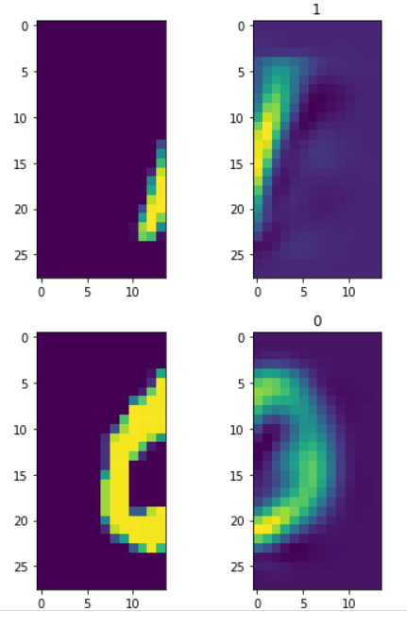
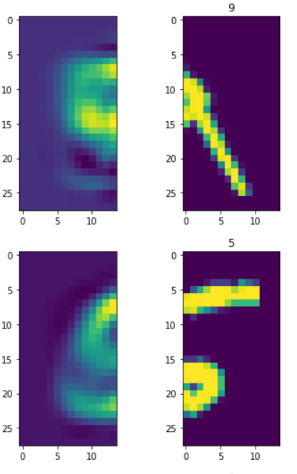
RESULTS
LEFT VIEW
RECONSTRUCTED
RIGHT VIEW
RECONSTRUCTED
LEFT VIEW
RIGHT VIEW

Slide 20
THANK YOU

